Slide 1
Welcome to Technical Bootcamp: Day 2

Slide 2

A look into the Day 2 agenda:
Day 2
Design Presentations: Spark for Data Science
Break
Please refer to the descriptions below for reference
Design Presentation: Security
Design Presentation: Monitor & Manage
Types of activities:
Attendees will participate in four different types of activities:
Break
PoC Challenge 3
Keynote
Labs
Long Break
Presentations
Challenges
Continue PoC Challenge 3
Breakout Activity
Location of activities:
Each activity will take place in the following location:
Break
PoC Challenge 4
All-up Session: Teams bridge in calendar invite
Break
Breakout Activity: “Meet Now” function in Teams Table Group channel
Continue PoC Challenge 4
Independent working time: No meeting, working in Spektra labs
Closing

Slide 3
Spark for Data Science
Ciprian Jichici
Carey Payette

Slide 4

Agenda
1 Spark in Synapse
How Spark is utilized within Synapse.
2 Notebooks
Understand the notebook paradigm and how to use them in Synapse.
3 Machine Learning with Synapse and Azure ML
How to train and deploy models with Synapse and Azure Machine Learning.

Slide 5
Spark in Azure Synapse Analytics

Slide 6

Azure Synapse Apache Spark - Summary
Apache Spark 2.4 derivation
Linux Foundation Delta Lake 0.4 support
.Net Core 3.0 support
Python 3.6 + Anaconda support
Tightly coupled to other Azure Synapse services
Integrated security and sign on
Integrated Metadata
Integrated and simplified provisioning
Integrated UX including nteract based notebooks
Fast load of SQL Analytics pools
Core scenarios
Data Prep/Data Engineering/ETL
Machine Learning via Spark ML and Azure ML integration
Extensible through library management
Efficient resource utilization
Fast Start
Auto scale (up and down)
Auto pause
Min cluster size of 3 nodes
Multi Language Support
.Net (C#), PySpark, Scala, Spark SQL, Java

Slide 7


Spark Notebook Execution with the Synapse Job Service
AAD
Synapse Studio
Synapse Service
Gateway
Auth Service
Job Service Frontend
…
Resource Provider
Spark API Controller
DB
Job Service Backend
Azure
Instance Creation Service
Spark Plugin
…
DB
DB
Spark Instance
VM
VM
VM
VM
VM
VM
Notes:
In Synapse Studio, the user attaches Notebook to Spark pool and enters one or more Spark statements (code blocks).
The Notebook client gets user token from AAD and sends a Spark session create request to the Synapse Gateway.
Synapse Gateway authenticates the request and validates authorizations on the Workspace and Spark pool and forwards it to the Spark (Livy) controller hosted in Synapse Job Service frontend.
The Job Service frontend forwards the request to Job Service backend that creates two jobs – one for creating the cluster and the other for creating the Spark session.
The Job service backend contacts Synapse Resource Provider to obtain Workspace and Spark pool details and delegates the cluster creation request to Synapse Instance Creation Service.
Once the Spark Instance is created, the Job Service backend forwards the Spark session creation request to the Livy endpoint in the cluster.
Once the Spark session is created the Notebook client sends Spark statements to the Job Service frontend.
Job Service frontend obtains the actual Livy endpoint for the cluster created for the particular user from the backend and sends the statement directly to Livy for execution.

Slide 8
Synapse Spark Instance Creation
Azure Resource Provider
3
Provision Resources
Spark Instance
2
Create VMs with
Specialized VHD
Subnet
VM – 001
VM – 002
VM – 003
VM – 004
VM – 005
Spark Executors
Spark Executors
Spark Executors
Spark Executors
Hive Metastore
YARN NM - 01
Livy - 01
YARN NM - 02
Zookeeper - 01
Zookeeper - 02
Zookeeper - 03
YARN RM - 01
YARN RM - 02
YARN NM - 03
YARN NM - 04
Node Agent
Node Agent
Node Agent
Node Agent
Node Agent
1
Create Cluster
Synapse Cluster
Service
(Control Plane)
4
Heartbeats
Heartbeat sequence
Notes:
Synapse Job Service sends request to Cluster Service for creating clusters per the description in the associated Spark pool.
Cluster Service sends request to Azure using Azure SDK to create VMs (required plus additional) with specialized VHD.
The specialized VHD contains bits for all the services that are required by the Cluster type (for e.g. Spark) with prefetch instrumentation.
Once VM boots up, the Node Agent sends heartbeat to Cluster Service for getting node configuration.
The nodes are initialized and assigned roles based on their first heartbeat.
Extra nodes get deleted on first heartbeat.
After Cluster Service considers the cluster ready, it returns the Livy end-point to the Job Service.

Slide 9
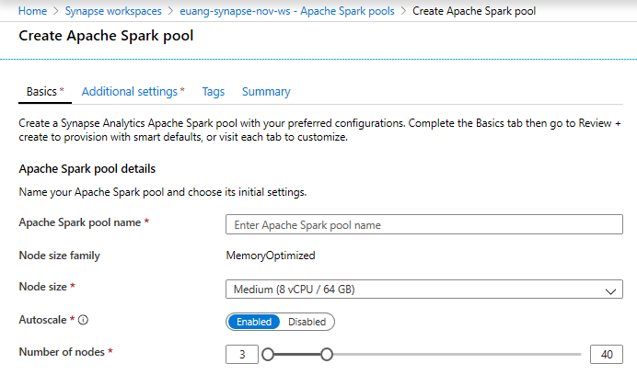
Creating a Spark pool (1 of 2)
Provision Spark Pool through Azure Portal with default settings or per requirements
Basic Settings – Minimum details required from user
Only required field from user
Default Settings

Slide 10
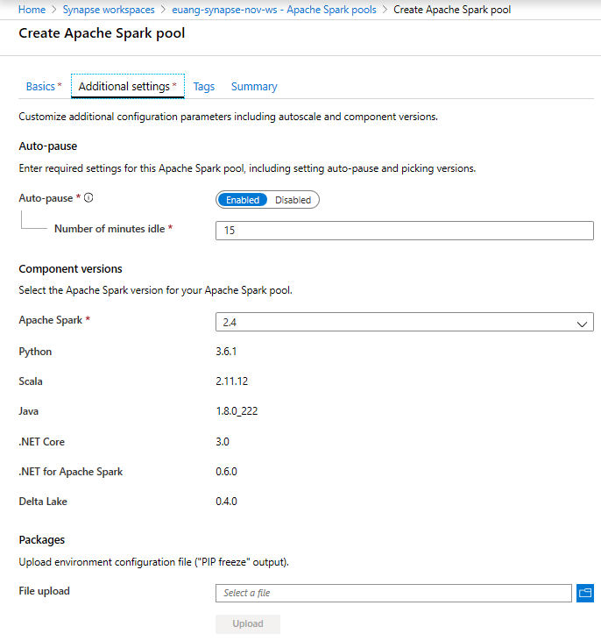
Creating a Spark pool (2 of 2) - optional
Additional Settings offer optional settings to customize Spark pool
Customize component versions, auto-pause
Import libraries by providing text file containing library name and version

Slide 11
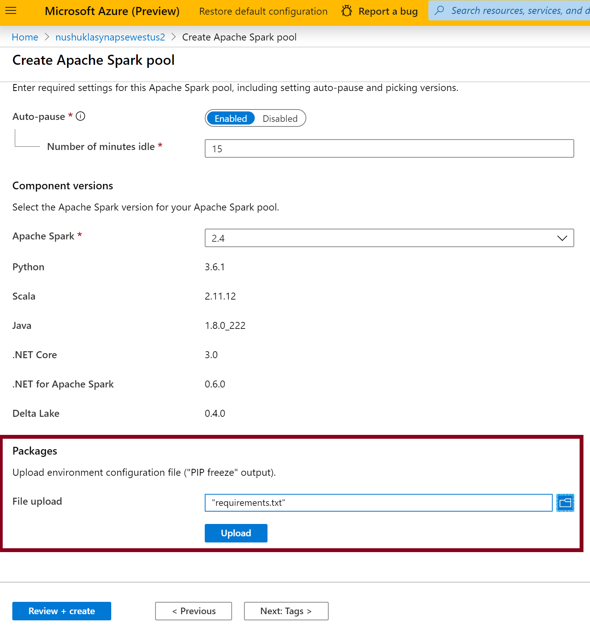
Library Management - Python
In the Portal Specify the new requirements while creating Spark Pool in Additional Settings blade
Overview
Customers can add new python libraries at Spark pool level
Benefits
Input requirements.txt in simple pip freeze format
Add new libraries to your cluster
Update versions of existing libraries on your cluster
Libraries will get installed for your Spark pool during cluster creation
Ability to specify different requirements file for different pools within the same workspace
Constraints
The library version must exist on PyPI repository
Version downgrade of an existing library not allowed

Slide 12
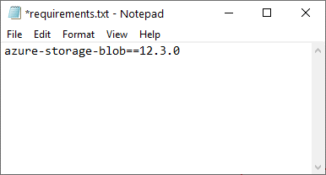
Python Library Requirements Format
Overview
The requirements text file has specific format requirements. These files are traditionally created in Python environments by running the pip freeze command, but are also easy to create by hand.
File must be named requirements.txt.
Each line contains a requirement specifier.
This must contain at least the package name. You can also specify optional extras, an operator and version numbers according to the PIP requirements file standard.
The basic operators used by version specifiers are:
An exact version (using ==).
A minimum version (using > or >=).
A maximum version (using < or <=).
The extras listed in square brackets ([]) allow you to install additional components or variants of the library.

Slide 13
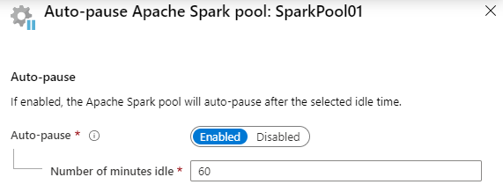
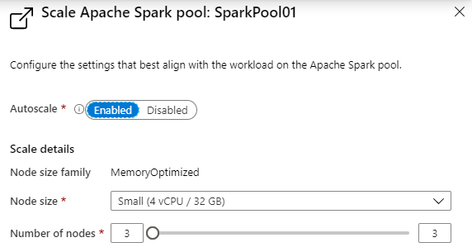
Spark Pools - Configuring
Auto-pause
Enables the pool to automatically stop running when no Spark applications (e.g., Notebooks) are running.
Autoscale
Enables the pool to automatically adjust the number of running nodes (VM’s) supporting the Spark pool.
Note: Just because a pool is running, does not mean all the nodes allowed to run, according to the scale configuration, are actually running. They will be allocated on demand as new Notebooks are executed, up to the limit configured in autoscale.

Slide 14
Notebooks in Azure Synapse Analytics

Slide 15
The Notebook Paradigm – one UI for data science
Collect Data
Retrieve Files
Evaluate
Model
Test Performance
Query SQL Databases
Compare Models
Call Web Services
Validate Model
“Scrape” Web Pages
Visualize Performance
Execute arbitrary:
- Python code
- R code
- SQL queries
- Shell commands
Prepare Data
Explore Data
Deploy
Model
Export Model File
Validate Data
Prepare Job
Clean Data
Deploy Container
Featurize Data
Re-package Model
Notebook
(Synapse Spark)
Train Model
Prepare Training Set
Experiment
Test Model
Visualize Performance

Slide 16

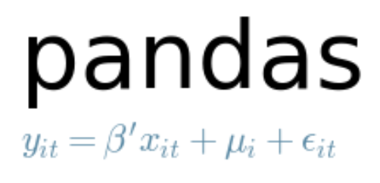








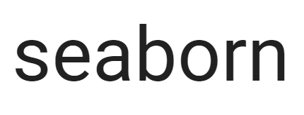


Examples of tools for data science used in Notebooks
Core frameworks and tools
Machine Learning & Deep Learning
Keras
PyTorch
Visualization

Slide 17
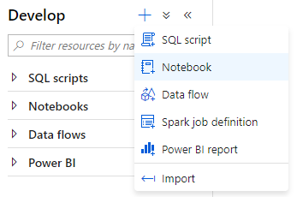
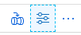
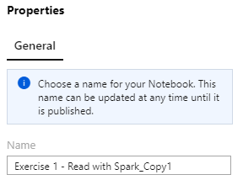
Creating a Notebook
Notebook creating
Create a new notebook within the Develop hub of Synapse Studio.
Notebook naming
The name of the Jupyter notebook can be set in the Properties dialog. It must be set before publishing and cannot be changed later.

Slide 18
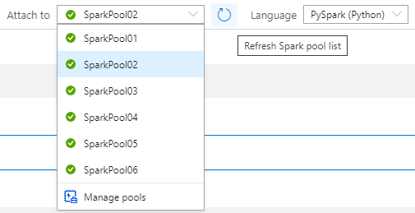
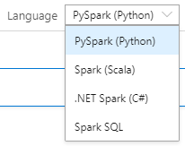
Notebook setup
Selecting the Spark pool to attach to
In the notebook toolbar, select the Spark pool to attach to before running any cells in the notebook.
Notebook default language
The default language used for all cells in the notebook is selected in the Language drop down.
You can override this for any particular cell to use a different language by using the appropriate cell magic (covered later).

Slide 19
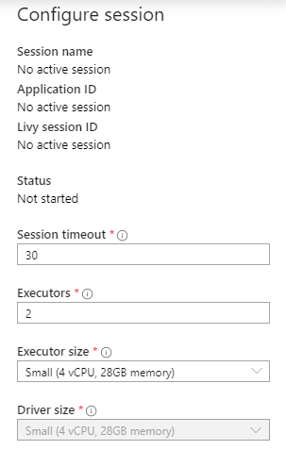
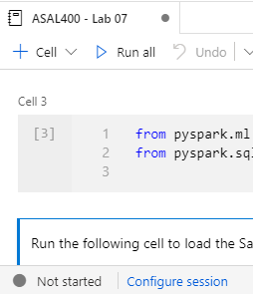
Notebook setup – Session configuration
A Spark session is created upon first run of any cell in a notebook. The configuration for a Spark session can only be set before it is created.
The Spark session allocates one Spark application.
This Spark application consumes a fixed set of resources, as defined in the session configuration. These resources are reserved from the total resources available in the Spark pool upon session start.
Each session reserves resources for at least one driver process and two executor processes. You can configure the size of executors, as well as the number of executors. The size of the driver is always the same as the executors.
A session ends when the notebook is closed or when the session timeout is reached without any activity in the notebook. You can configure the session timeout.

Slide 20
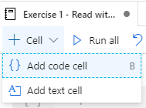
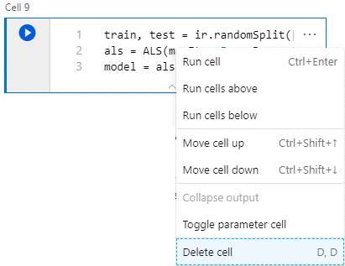
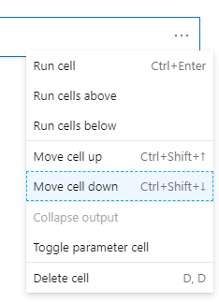
Notebook capabilities – Cell management
Add code or text cells
Remove code or text cells
Adjust cell order

Slide 21
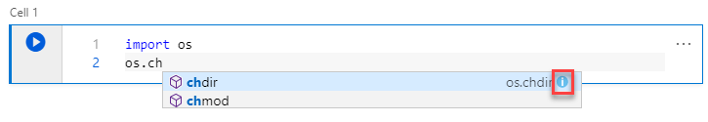
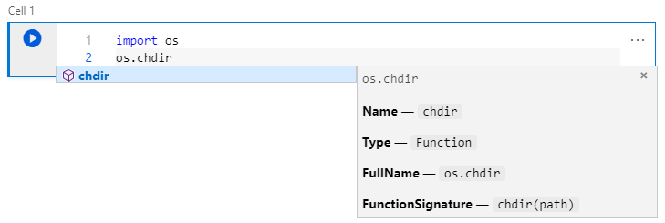
Notebook capabilities – Editing code
Statement completion
Use Ctrl + Space to display
Inline documentation
Select the information tooltip to display

Slide 22
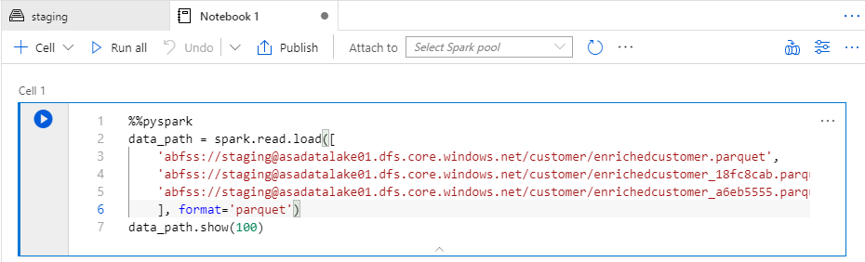
Notebook capabilities – Editing code
Cell magics
Use cell magics to change the language used when interpreting the cell.
These must be the first line in the cell.
Magic | Description
%%pyspark | Execute Python code against Spark Context.
%%spark | Execute Scala code against Spark Context.
%%sql | Execute Spark SQL query against Spark Context.
%%csharp | Execute Spark.NET C# code against Spark Context.

Slide 23
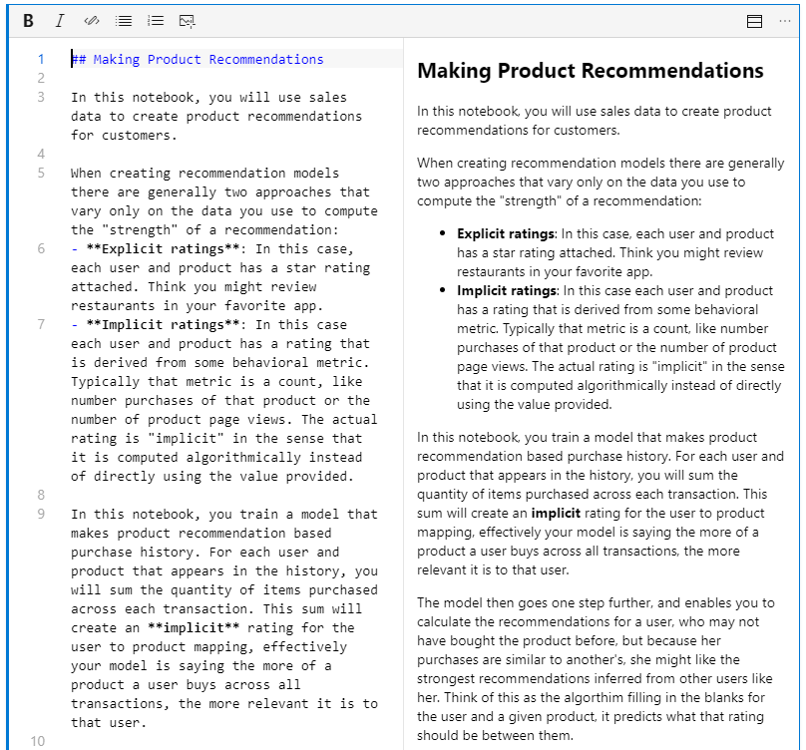
Notebook capabilities – Editing text cells
Support for GitHub flavored markdown
Notebooks support GitHub flavored markdown, enabling limited text formatting, links, lists, code blocks and images.

Slide 24
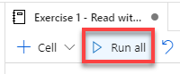
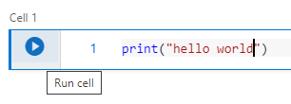
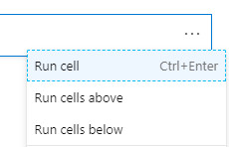
Notebook capabilities – Running cells
Run all cells from toolbar
Run current cell from toolbar from cell itself

Slide 25
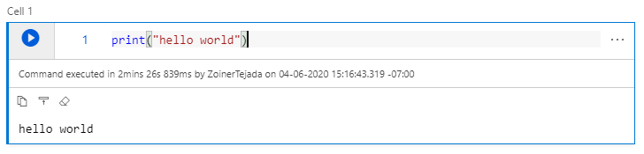
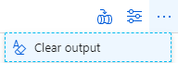
Notebook capabilities – Cell output
Cell output
Clear all cells output from toolbar

Slide 26
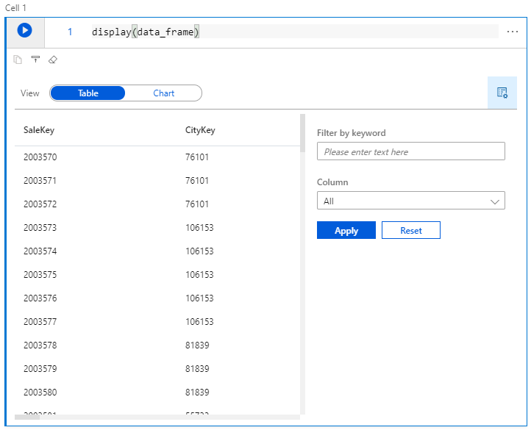
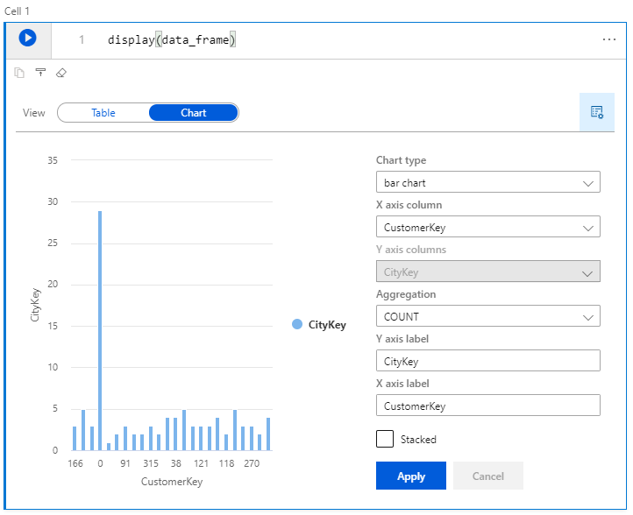
Spark Pools – Notebook capabilities
View DataFrame content as table or chart
Use the display function and pass in your dataframe.

Slide 27
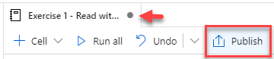
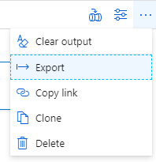

Spark Pools – Notebook capabilities
Saving (publishing)
Exporting (download the .ipynb)

Slide 28
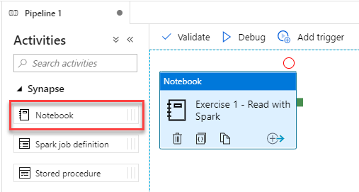
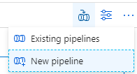
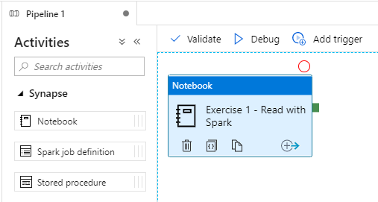
Notebook capabilities – Use in pipelines
Notebooks are pipeline activities
Execute a notebook as a step in a new pipeline

Slide 29
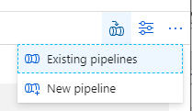
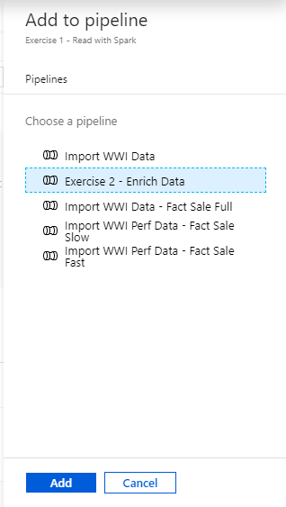
Notebook capabilities – Use in pipelines (2)
Execute a notebook as a step in an existing pipeline

Slide 30
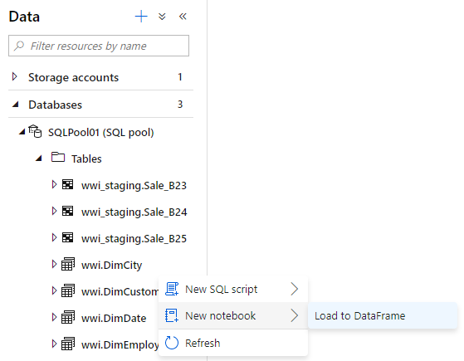
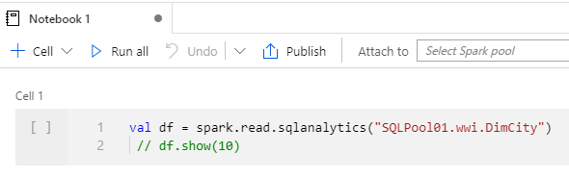
Notebook capabilities – Querying SQL Pools
Loading a SQL Pool table to a DataFrame

Slide 31
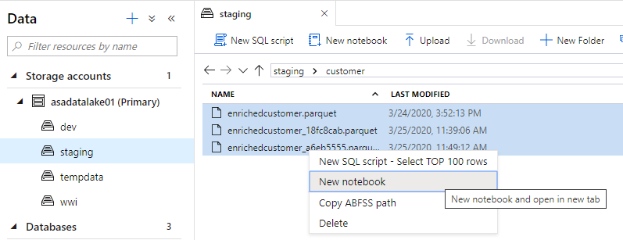
Notebook capabilities – Querying Parquet Files
Loading Parquet files to a DataFrame

Slide 32
Pop Quiz #4
What types of library sources are supported in Azure Synapse Spark?
Maven
Spark
PyPi

Slide 33
Pop Quiz #4
What types of library sources are supported in Azure Synapse Spark?
Maven
Spark
PyPi

Slide 34
Machine Learning with Azure Synapse Analytics and Azure Machine Learning

Slide 35




Making predictions with T-SQL
Create the model
Register the model
Use the model
Azure Machine Learning or Azure Synapse Spark
Azure Synapse SQL
Azure Synapse SQL
Notebook
SQL Script
SQL Script
Train Model
Read model
Load from Table
Convert to ONNX
Load into Table
Use Predict
Export to Storage
Insert Predictions
Storage
Models
Notes:
The diagram illustrates the approach the Azure Synapse Analytics enables for machine learning.
Train the machine learning models using notebooks run within Azure Machine Learning or Azure Synapse Spark. Use the machine learning framework of choice to do so.
Within this notebook, convert the model into the ONNX format and then upload the model to Azure Storage.
From there, run a T-SQL script in Azure Synapse SQL to load the model into a table in the database.
After this, use the model within T-SQL scripts running Azure Synapse SQL by loading the model from the table, and using it with the Predict statement to score data sourced from a table in the database. The scored results could then be used directly or be inserted into a target table for later querying of the predictions.

Slide 36
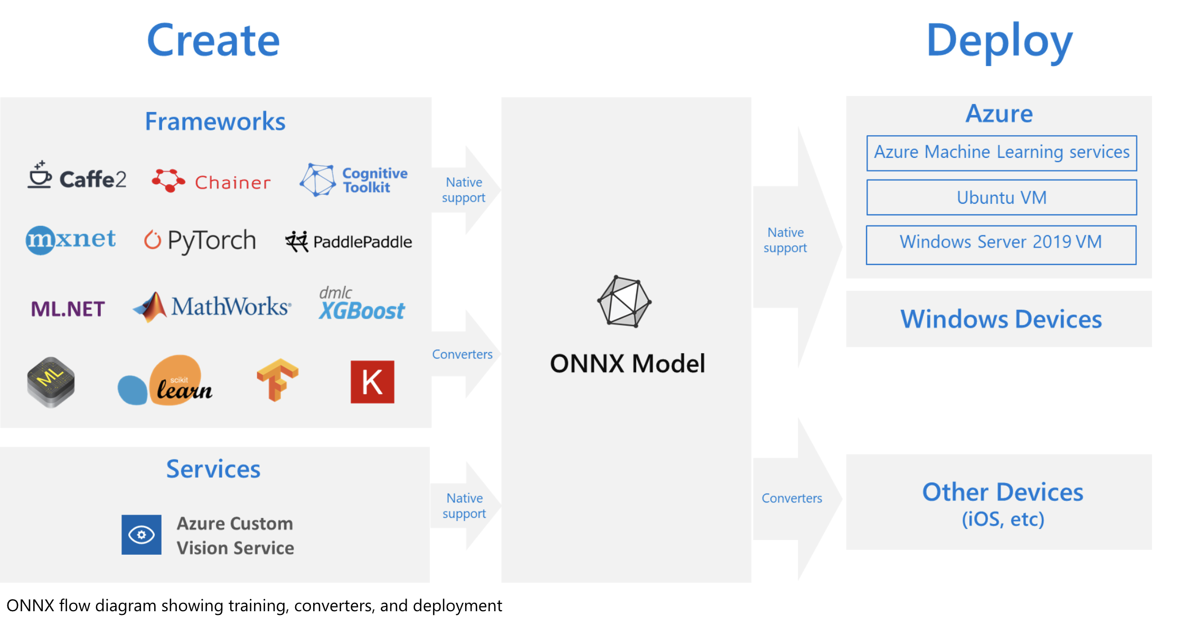
What is ONNX?
Notes:
The challenges of optimizing the performance of machine learning models in production is extremely hard considering the range of hardware capabilities on different platforms such as cloud vs edge, CPU vs GPU etc. and couple that with the variety of frameworks that available for building and training the machine learning models.
To support the idea of providing users the flexibility to train their machine learning models on framework of their choice, and run that model anywhere with optimal performance, is at the core of Open Neural Network Exchange (ONNX) format for representing machine learning models. ONNX is an open format, that is supported by a community of partners, including Microsoft, who create compatible frameworks and tools.
You can create ONNX models from many frameworks, including PyTorch, Chainer, Microsoft Cognitive Toolkit (CNTK), MXNet, ML.Net, TensorFlow, Keras, SciKit-Learn, and more. ONNX Runtime is optimized for both cloud and edge and works on Linux, Windows, and Mac, and it also integrates with accelerators on different hardware such as TensorRT on NVidia GPUs. ONNX models can be deployed to the cloud using Azure Machine Learning and ONNX Runtime. They can also be deployed to Windows 10 devices using Windows ML. They can even be deployed to other platforms using converters that are available from the ONNX community.
The interoperability you get with ONNX makes it possible to get great ideas into production faster. With ONNX, data scientists can choose their preferred framework for the job. Similarly, developers can spend less time getting models ready for production, and deploy across the cloud and edge.
Data scientists: use the framework of their choice to create and train models
Developers: deploy models cross-platform with minimal integration work

Slide 37









Modern Data Warehouse
INGEST
PREPARE
TRANSFORM & ENRICH
SERVE
VISUALIZE
AZURE SYNAPSE ANALYTICS
Synapse SQL (Provisioned)
Synapse Pipeline
Synapse SQL (Provisioned)
Data Sources
Synapse SQL (Serverless)
Synapse Pipeline
Power BI
OR
OR
Synapse Pipelines
Synapse SQL (Serverless)
Synapse Spark
Synapse Spark
Synapse SQL (Serverless)
STORE
ADLS Gen 2
Storage Account
Data Lake

Slide 38

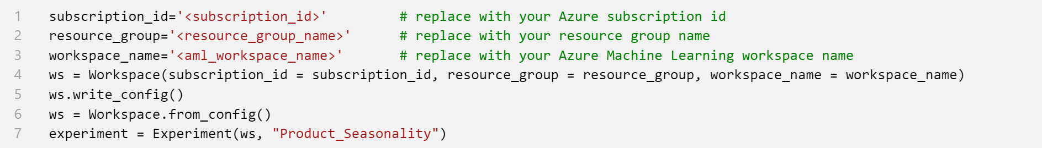


Using Azure Machine Learning from Synapse
Synapse Workspace
Spark Notebook
PySpark -> Azure ML SDK
Spark
Pool
Azure Machine Learning Workspace
Compute
Experiment
Model
Deployment
AutoML
Pipeline
Image

Slide 39
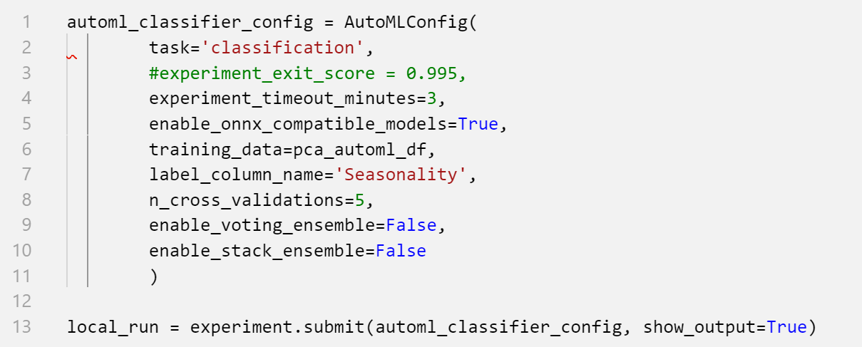
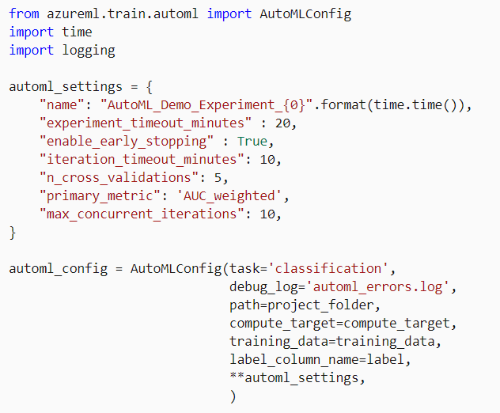
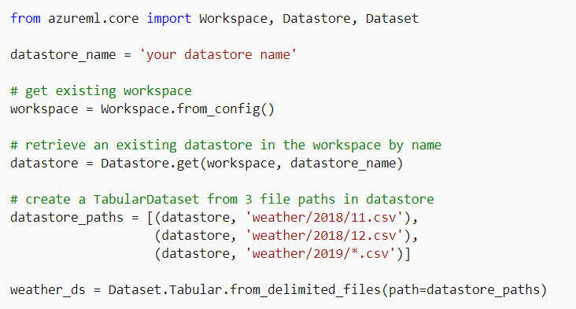
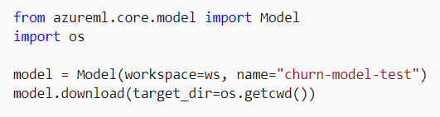
AutoML compute and registry services
Synapse Workspace
Spark Notebook
AutoML Integration
Spark Pool
Local compute
(Spark node)
Azure Machine Learning Workspace
Remote Compute (Azure ML)
DataStores
Datasets
Model Registry

Slide 40
Thank you

Slide 41

Break
Please take this time for a short 15 minute break
Relax and come back refreshed for our next activity
If at anytime you require assistance please send a message to the “Need help – ask here” channel in the Microsoft Teams site for this event

Slide 42
Security in Azure Synapse
Ciprian Jichici
Carey Payette

Slide 43
Agenda
1 Security baseline
Synapse Analytics security baseline
2 Network security
Synapse Managed Virtual Network and Managed private endpoints

Slide 44
Security baseline for Synapse Analytics

Slide 45
The Security Baseline for Synapse Analytics
Contains recommendations that will help you improve the security posture of your deployment
Network security | Protect with VNETs Monitor configuration and traffic of VNETs, subnets and network interfaces Use Advanced Threat Protection (ATP) and DDoS Protection, Record network packets, Use tags for network security groups
Logging and monitoring | Update time synchronization for your compute deployments, Central security log management, Enable auditing on the Azure SQL server-level, Configure security log storage retention, Use advanced Threat Protection (ATP) for Azure SQL Database in conjunction with Azure Security Center to monitor and alert on anomalous activity
Identity and access control | Maintain an inventory of administrative accounts Change default passwords where applicable Use dedicated administrative accounts, Use AAD single sign-on Use multi-factor authentication for all AAD-based access Use a Privileged Access Workstation (PAW) with Multi-Factor Authentication (MFA) configured to log into and configure Azure resources Use Azure Active Directory security reports for generation of logs and alerts when suspicious or unsafe activity occurs in the environment. Manage Azure resources from only approved locations Create an Azure Active Directory (AD) administrator for the Azure SQL Database server in your Synapse SQL pool. Regularly review and reconcile user access In support scenarios where Microsoft needs to access data related to the Azure SQL Database in your Synapse SQL pool, Azure Customer Lockbox provides an interface for you to review and approve or reject data access requests Use Azure Active Directory (Azure AD) Identity Protection and risk detection features to configure automated responses to detected suspicious actions related to user identities. Configure Azure Active Directory (AD) authentication with Azure SQL and enable diagnostic settings for Azure Active Directory user accounts, sending the audit logs and sign-in logs to a Log Analytics workspace. Configure desired alerts within Log Analytics

Slide 46
Security Baseline for Synapse Analytics
Contains recommendations that will help you improve the security posture of your deployment
Data protection | Maintain an inventory of sensitive Information; Isolate systems storing or processing sensitive information; For any Azure SQL Database in your Synapse SQL pool storing or processing sensitive information, mark the database and related resources as sensitive using tags. Configure Private Link in conjunction with network security group (NSG) service tags on your Azure SQL Database instances to prevent the exfiltration of sensitive information. Encrypt all sensitive information in transit. Use the Azure Synapse SQL Data Discovery & Classification feature. Data Discovery & Classification provides advanced capabilities built into Azure SQL Database for discovering, classifying, labeling & protecting the sensitive data in your databases. Use RBAC to manage access to Azure SQL databases in your Synapse SQL pool Encrypt sensitive information at rest: use TDE (Transparent data encryption); Log and alert on changes to critical Azure resources (Azure Monitor : Activity Log and alerts on Synapse in the Azure portal)
Vulnerability management | Run automated vulnerability scanning tools; Compare back-to-back vulnerability scans (Vulnerability Assessment is a scanning service built into Azure Synapse SQL.); Use a risk-rating process to prioritize the remediation of discovered vulnerabilities (Data Discovery & Classification built into Azure Synapse SQL)
Inventory and asset management | Use automated asset discovery solution (Azure Resource Graph); Maintain asset metadata (Apply tags to Azure resources). Delete unauthorized Azure resources. Define a list of approved Azure resources related to your Synapse SQL pool. Monitor for unapproved Azure resources (use Azure Policy and Azure Resource Graph) Use only approved Azure services Any resource related to your Synapse SQL pool that is required for business operations, but may incur higher risk for the organization, should be isolated within its own virtual machine and/or virtual network and sufficiently secured with either an Azure Firewall or Network Security Group.
Secure configuration | Use Azure Policy aliases in the "Microsoft.Sql" namespace to create custom policies to audit or enforce the configuration of resources related to your Synapse SQL pool. You may also make use of built-in policy definitions for Azure Database/Server, such as: Deploy Threat Detection on SQL servers / SQL Server should use a virtual network service endpoint. If using custom Azure Policy definitions, use Azure DevOps or Azure Repos to securely store and manage your code. Implement automated configuration monitoring for Azure resources ( Azure Security Center) Manage Azure secrets securely:TDE; Use Managed Identities to provide Azure services with an automatically managed identity in Azure Active Directory (AD); Implement Credential Scanner to identify credentials within your code
Notes:
https://docs.microsoft.com/en-us/azure/synapse-analytics/security-baseline for more details on the security baseline

Slide 47
Security Baseline for Synapse Analytics
Contains recommendations that will help you improve the security posture of your deployment
Malware defense | Pre-scan files to be uploaded to non-compute Azure resources (Microsoft anti-malware is enabled on the underlying host that supports Azure services. Pre-scan any content being uploaded to non-compute Azure resources, such as App Service, Data Lake Storage, Blob Storage, Azure SQL Server, etc. )
Data recovery | Ensure regular automated back-ups: Snapshots of your Synapse SQL pool are automatically taken throughout the day creating restore points. Periodically test your restore points to ensure your snapshots are valid. Ensure protection of backups and customer-managed keys: By default, data in a storage account is encrypted with Microsoft-managed keys. You can rely on Microsoft-managed keys for the encryption of your data, or you can manage encryption with your own keys. If you are managing your own keys with Key Vault, ensure soft-delete is enabled
Notes:
https://docs.microsoft.com/en-us/azure/synapse-analytics/security-baseline for more details on the security baseline

Slide 48
Network Security in Synapse

Slide 49
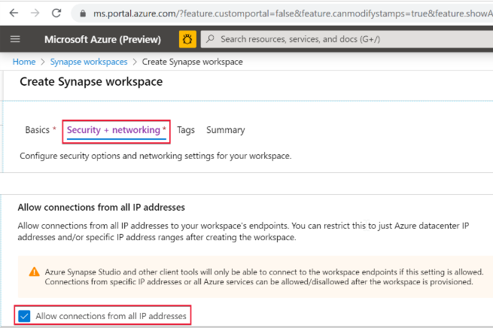
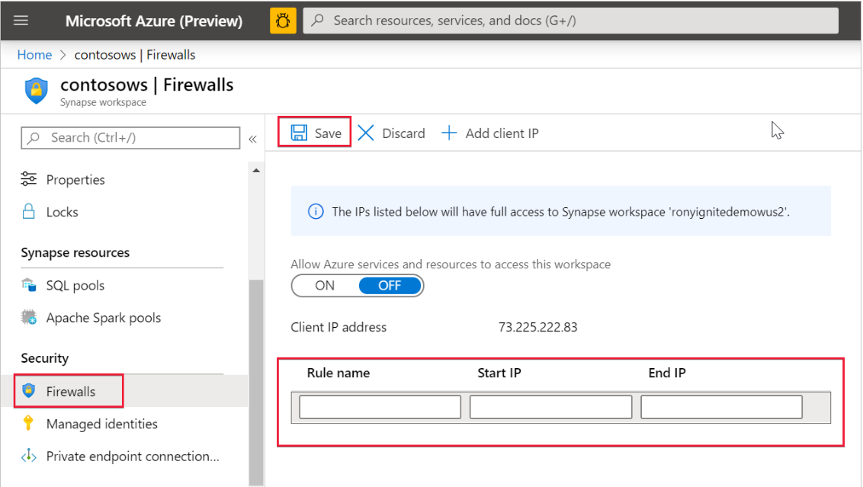
Synapse Workspace IP firewall rules
Select Security + networking and check Allow connections from all IP addresses during workspace creation
OR
(after the workspace is created)
Select Firewalls under Security from Azure portal. To add a new IP firewall rule, give it a name, Start IP, and End IP. Select Save when done

Slide 50
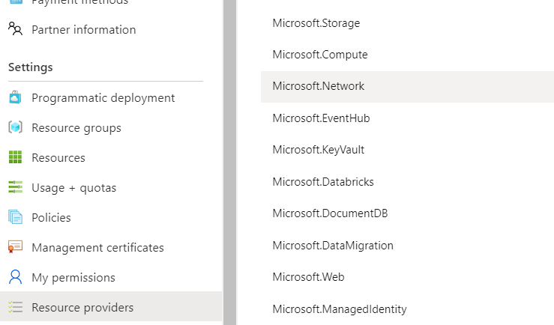
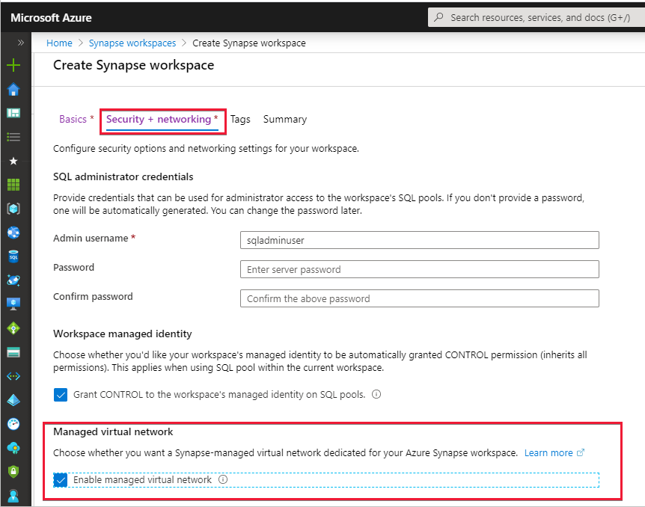
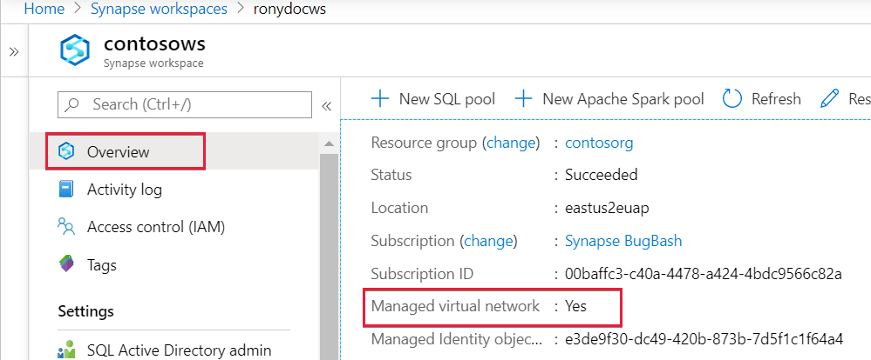
Create an Azure Synapse workspace with a Managed workspace Virtual Network
1. Register the Network resource provider on the subscription: All services: subscription -> select Subscriptions ->select Resource providers -> Microsoft.Network -> Register
(powershell:Register-AzResourceProvider -ProviderNamespace Microsoft.Network)
2. Create a Synapse workspace and Enable Managed Virtual Network
3. Check settings
Notes:
A Managed workspace VNet within Azure Synapse Analytics can only be deployed when you create the Azure Synapse workspace.
When you create your Azure Synapse workspace, you can choose to associate it to a VNet. The VNet associated with your workspace is managed by Azure Synapse. This VNet is called a Managed workspace Vnet.
Benefits
With a Managed workspace Virtual Network you can offload the burden of managing the Virtual Network to Azure Synapse.
You don't have to configure inbound NSG rules on your own Virtual Networks to allow Azure Synapse management traffic to enter your Virtual Network. Misconfiguration of these NSG rules causes service disruption for customers.
You don't need to create a subnet for your Spark clusters based on peak load.
Managed workspace Virtual Network along with Managed private endpoints protects against data exfiltration. You can only create Managed private endpoints in a workspace that has a Managed workspace Virtual Network associated with it.

Slide 51


Managed private endpoints for SQL pool and SQL on-demand and other data sources
In the Studio, select Manage in the left navigation, then select Managed Virtual Networks to see the list of managed private endpoints or to add an endpoint to other data sources .
When a workspace is created, Azure Synapse automatically creates two Managed private endpoints to SQL pool and SQL on-demand in that workspace.
Notes:
Managed private endpoints are private endpoints created in the Managed workspace Microsoft Azure Virtual Network establishing a private link to Azure resources. Azure Synapse manages these private endpoints on your behalf.
Only supported in Azure Synapse workspaces with a Managed workspace Virtual Network
Initially created in a “Pending” state in Azure Synapse, initiates an approval workflow, and can be approved/rejected by the Private link resource owner.
Only a Managed private endpoint in an approved state can send traffic to a given private link resource.

Slide 52

Managed VNets in the Synapse Workspace
The two Managed private endpoints to SQL pool and SQL on-demand automatically created in Synapse when the Managed workspace VNet is deployed.
Synapse Workspace
Managed VNet
Managed
private endpoint to SQL on-demand
Workspace
SQL on-demand
Synapse Studio
Managed
private endpoint to SQL Pool
Workspace
SQL Pool
Managed private endpoint
Spark Clusters
Other data sources
that support Private Link
(e.g. Cosmos DB,
Azure Storage, ADLS etc.)
The private endpoint establishes a private link between your
Azure Synapse Analytics workspace and your data sources where traffic between your VNet and workspace traverses entirely over the Microsoft backbone network.
IMPORTANT
All outbound traffic from the Managed workspace VNet will be blocked in the future. It's recommended that you connect to all your data sources using Managed private endpoints.
Internet

Slide 53


Connecting to Synapse from On-Premise
On-Premise VNet
Synapse Workspace
Managed VNet
SQL On-Demand tenant
*.sql.azuresynapse.net
Managed private endpoint to SQL on-demand
SQL Pool tenant
*-ondemand.sql.azuresynapse.net
Managed PE to SQL Pool
Dev tenant
*.dev.sql.azuresynapse.net
Azure VNET
Subnet
VPN Gateway
Private endpoint
Private endpoint
Private endpoint
site-to-site
point-to-site
Notes:
Check this article to learn how to create private endpoins to your Azure Synapse workspace: https://docs.microsoft.com/en-us/azure/synapse-analytics/security/how-to-connect-to-workspace-with-private-links

Slide 54


Self-hosted Integration Runtime in Synapse Workspace
Azure Data Factory
*.frontend.clouddatahub.net
Azure ServiceBus
*.servicebus.windows.net
Optional, required when using the staged copy feature
Self-hosted Integration Runtime
(on-premise)
Azure Storage
*.core.windows.net
Optional, required when the Self-hosted integration runtime has auto-update enabled
443
download.microsoft.com
Synapse Workspace
Azure
Integration Runtime
Self-Hosted
Integration Runtime
Managed VNET
Workspace
SQL on-demand endpoint
Synapse Studio
Private endpoint to SQL on-demand
Private endpoint to SQL Pool
Workspace
SQL Pool
endpoint
Private endpoint
Spark Clusters
Supports up to 4 nodes for high availability and scalability
Other data sources
that support Private Link
(e.g. Cosmos DB, Azure Storage etc.)
Internet

Slide 55


Self-hosted Integration Runtime in Synapse Workspace
Whitelisting of specific public Azure endpoints
Whitelisting of IR-specific IP addresses

Slide 56
Thank You slide
Thank you

Slide 57
Monitor & Manage
Ciprian Jichici
Carey Payette

Slide 58
Agenda
1 Monitoring
Monitor resources within Synapse Studio and the Azure Portal.
2 Manage
Manage resources for optimal utilization and performance.

Slide 59


Discussion…
How has the role of a DBA changed in the era of managed Data- Warehouses-as-a-Service?

Slide 60

Monitor within Monitor Hub
Overview
Within Synapse Studio you can monitor Pipeline Runs, Trigger Runs, Spark applications and SQL requests.

Slide 61


Monitor SQL Requests
Overview
Monitor SQL requests and view the content of the SQL queries.
Benefits
View SQL requests, filter by time, user, workload group, and other properties.

Slide 62

Monitor Orchestration
Overview
Monitor orchestration in the Synapse workspace for the progress and status of pipeline
Benefits
Track all/specific pipelines
Monitor pipeline run and activity run details
Find the root cause of pipeline failure or activity failure

Slide 63


Monitor Spark applications
Overview
Monitor Spark pools, Spark applications for the progress and status of activities
Benefits
Monitor Spark pools for the status as paused, active, resume, scaling and upgrading
Track the usage of resources

Slide 64

Monitor SQL Pools
Overview
Monitor SQL Pool in Azure Portal for overall usage and query activities.
Benefits
Access SQL Audit Logs for my SQL computes
Monitor status and progress of all/specific activities
Dashboard view to monitor performance
Get to know scale of SQL compute resource

Slide 65
Manage

Slide 66
Workload Management
Pillars of Workload Management
Overview
It manages resources, ensures highly efficient resource utilization, and maximizes return on investment (ROI).
Synapse is moving away from Resource Class and Concurrency Slots to Workload Management.
The three pillars of workload management are
Workload Classification – To assign a request to a workload group and setting importance levels.
Workload Importance – To influence the order in which a request gets access to resources.
Workload Isolation – To reserve resources for a workload group.
Classification
Importance
Isolation

Slide 67
Workload classification
Overview
Map queries to allocations of resources via pre-determined rules.
Use with workload importance to effectively share resources across different workload types.
If a query request is not matched to a classifier, it is assigned to the default workload group.
Benefits
Map queries to both Resource Management and Workload Isolation concepts.
Monitoring DMVs
sys.workload_management_workload_classifiers sys.workload_management_workload_classifier_details
Query DMVs to view details about all active workload classifiers.
CREATE WORKLOAD CLASSIFIER classifier_name
WITH
(
WORKLOAD_GROUP = 'name’
, MEMBERNAME = ‘security_account'
[ [ , ] IMPORTANCE = {LOW|BELOW_NORMAL|NORMAL|ABOVE_NORMAL|HIGH} ] )
[ [ , ] WLM_LABEL = 'label' ]
[ [ , ] WLM_CONTEXT = 'name' ]
[ [ , ] START_TIME = 'start_time' ]
[ [ , ] END_TIME = 'end_time' ]
)[ ; ]
WORKLOAD_GROUP: maps to an existing resource class
IMPORTANCE: specifies relative importance of request
MEMBERNAME: database user, role, AAD login or AAD group

Slide 68


Workload importance
Overview
Queries past the concurrency limit enter a FiFo queue
By default, queries are released from the queue on a first-in, first-out basis as resources become available
Workload importance allows higher priority queries to receive resources immediately regardless of queue
Example Video
State analysts have normal importance.
National analyst is assigned high importance.
State analyst queries execute in order of arrival
When the national analyst’s query arrives, it jumps to the top of the queue
Azure Synapse
Analytics
CREATE WORKLOAD CLASSIFIER National_Analyst
WITH
(
WORKLOAD_GROUP = ‘analyst’
,IMPORTANCE = HIGH
,MEMBERNAME = ‘National_Analyst_Login’)
Notes:
Video example:
National Analyst is given a higher workload importance value

Slide 69
Workload Isolation
Overview
Allocate fixed resources to workload group.
Assign maximum and minimum usage for varying resources under load. These adjustments can be done live without having to take SQL Analytics offline.
Benefits
Reserve resources for a group of requests
Limit the amount of resources a group of requests can consume
Shared resources accessed based on importance level
Set Query timeout value. Get DBAs out of the business of killing runaway queries
Monitoring DMVs
sys.workload_management_workload_groups
Query to view configured workload group.
CREATE WORKLOAD GROUP group_name
WITH
(
MIN_PERCENTAGE_RESOURCE = value
, CAP_PERCENTAGE_RESOURCE = value
, REQUEST_MIN_RESOURCE_GRANT_PERCENT = value
[ [ , ] REQUEST_MAX_RESOURCE_GRANT_PERCENT = value ]
[ [ , ] IMPORTANCE = {LOW | BELOW_NORMAL | NORMAL | ABOVE_NORMAL | HIGH} ]
[ [ , ] QUERY_EXECUTION_TIMEOUT_SEC = value ]
)[ ; ]
Notes:
https://docs.microsoft.com/en-us/azure/sql-data-warehouse/sql-data-warehouse-workload-isolation

Slide 70
Discussion…
What are some of the advantages and disadvantages of workload isolation versus SQL Pool scaling?
Notes:
Scale can increase overall capacity, but empties the cache which slows performance.
Workload isolation can be more responsive to quick changes in workload.

Slide 71


Azure Advisor recommendations
Suboptimal Table Distribution
Reduce data movement by replicating tables
Data Skew
Choose new hash-distribution key
Slowest distribution limits performance
Cache Misses
Provision additional capacity
Tempdb Contention
Scale or update user resource class
Suboptimal Plan Selection
Create or update table statistics

Slide 72

Maintenance windows
Overview
Choose a time window for your upgrades.
Select a primary and secondary window within a seven-day period.
Windows can be from 3 to 8 hours.
24-hour advance notification for maintenance events.
Benefits
Ensure upgrades happen on your schedule.
Predictable planning for long-running jobs.
Stay informed of start and end of maintenance.

Slide 73
Manage Summary
Resource contention can be mitigated by applying Workload Management in Azure Synapse Analytics.
Workload Classification: Assign a request to a workload group and set importance levels.
Workload Importance: Influence the order in which a request gets access to resources.
Workload Isolation: Reserve resources for a workload group.
Use Azure Advisor recommendations to identify suboptimal table distribution, data skew, cache misses, tempdb contention, and suboptimal plan selection.
Avoid disruptive system downtime due to system upgrades by configuring maintenance windows and notifications in Azure Synapse Analytics.
Notes:
Exploratory queries that were not time sensitive can saturate the available resources and delay the execution of higher priority queries supporting critical reports, how can one mitigate this?
Separate marketing workloads from say the finance workloads using workload management.
Configure Workload Management in Azure Synapse Analytics which serves to prevent this situation.
It manages resources, ensures highly efficient resource utilization, and maximizes return on investment (ROI).
The three pillars of Workload Management are:
Workload Classification – To assign a request to a workload group and set importance levels.
Workload Importance – To influence the order in which a request gets access to resources.
Workload Isolation – To reserve resources for a workload group.
If workload management does not suffice, note that online scaling (which allows you to increase the cluster size without incurring downtime) and multi-cluster (which allows you to have several different clusters supporting a single data warehouse) are features that are coming soon.
How can you identify issues such as suboptimal table distribution, data skew, cache misses, tempdb contention and suboptimal plan selection?
Leverage the Azure Advisor recommendations.
There is a balance between the data warehouse software staying up to date and when a customer can afford downtime that might result. How can they establish their preferences, so they are never caught off guard with an upgrade?
Leverage maintenance windows, a feature of Azure Synapse Analytics. Within this they can:
Choose a time window for upgrades.
Select a primary and secondary window within a seven-day period, where windows can be from 3 to 8 hours.
Receive 24-hour advance notification for maintenance events.

Slide 74

Mentimeter Poll
Scan QR Code
or Go to www.menti.com and use code
66 85 335

Slide 75
Thank you

Slide 76
Break
Please take this time for a short 15 minute break
Relax and come back refreshed for our next activity
If at anytime you require assistance please send a message to the “Need help – ask here” channel in the Microsoft Teams site for this event

Slide 77








POC Challenges 3 & 4: group-based lab exercises
GUIDE:
PoC Challenge
https://github.com/solliancenet/azure-synapse-analytics-workshop-300-2-day
Step 1: Go to your table group channel
Step 2: You will use your cloud lab login for Azure
Step 3: Login to Azure. Engage your table group via a Microsoft Teams “meet now” call to collaborate with each other (meet now button in upper right corner of application)

Slide 78

Day 2 Wrap Up
Thank you for your participation in the Day 2 Technical Boot Camp
What was covered today:
Implement a process that trains a machine learning model, registers it for use and utilizes the model for scoring using the Predict statement. ​
Apply security concepts including row level security, object level security, column level security, sensitive data discovery and classification and access controls to a customer scenario.
Address scenarios the involve the design of how to monitor and manage a solution implemented with Azure Synapse Analytics.
If at anytime you require assistance, please send a message to the “Need help – ask here” channel in the Microsoft Teams site for this event

Slide 79
A few takeaways
Never trust already existing data or structure
Make sure you run your data processes “pedal to the metal”
Always work on small subsets first
Assume all files are “bad” – “good” is just a nice surprise
Fail fast, change optics even faster
Don’t be shy of moving out of the SQL world
Think outside of the box
Explore first, then understand, then “solve”

Slide 80


We’d love to hear from you!
Day 1 | Day 2
Scan the QR code below using your smartphone or access the link https://aka.ms/BC_EMEA_Day1 You’ll also receive a link to this survey by email. You only need to complete it once. Answer the survey questions to provide your feedback on Day 1 of Boot Camp. Be honest. Every bit of feedback helps us improve. | Scan the QR code below using your smartphone or access the link https://aka.ms/BC_EMEA_Day2 You’ll also receive a link to this survey by email. You only need to complete it once. Answer the survey questions to provide your feedback on Day 2 of Boot Camp. Be honest. Every bit of feedback helps us improve.

